Slide 1

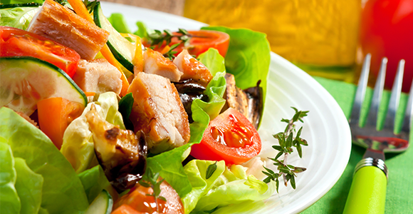
SMART EATING
Submitted By : COGNITIVE SQUADS
(Team 10)

Slide 2
Features :
To find near by restaurants.
Getting the menu of restaurants and also ingredients of the food items in that.
User can check for the item, that he is allergic to and can have his food accordingly from the restaurant.
User can add allergies that he is allergic to and when he checks for menu in any restaurant, he can differentiate the items he is allergic to.
You can also get recipes for any item to make and can know how to make it.

Slide 3
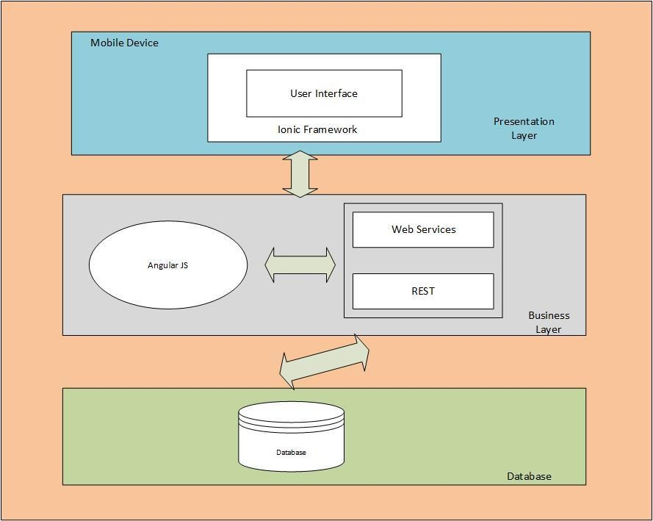
Architectural Diagram :

Slide 4










Technologies and API used :

Slide 5


